Slide 1
Video Report for Banco Pichin
Kavya Ganesan, Ben Browner, Chima Anyanwu

Slide 2
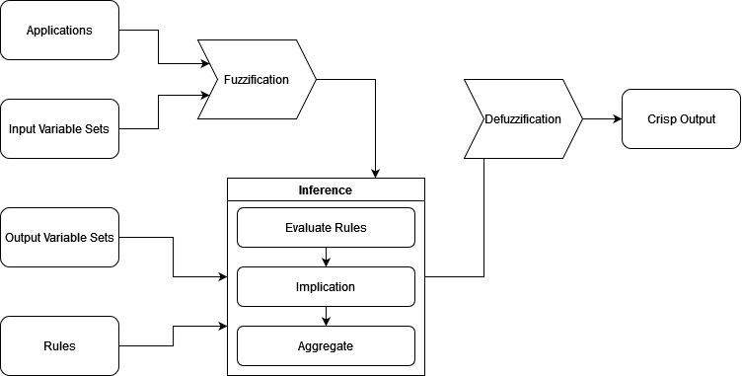
Executive Summary

Slide 3
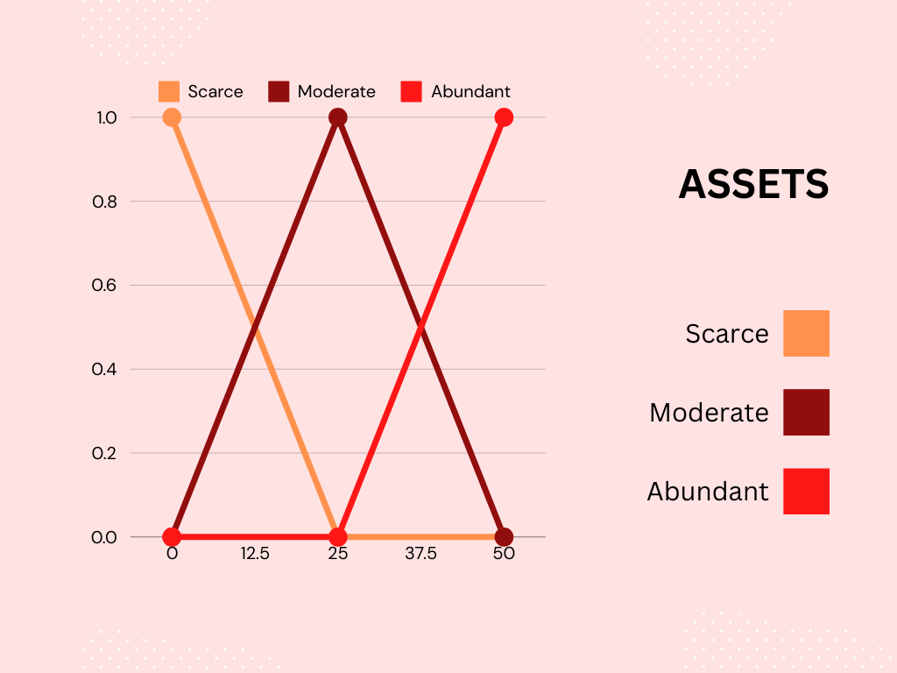
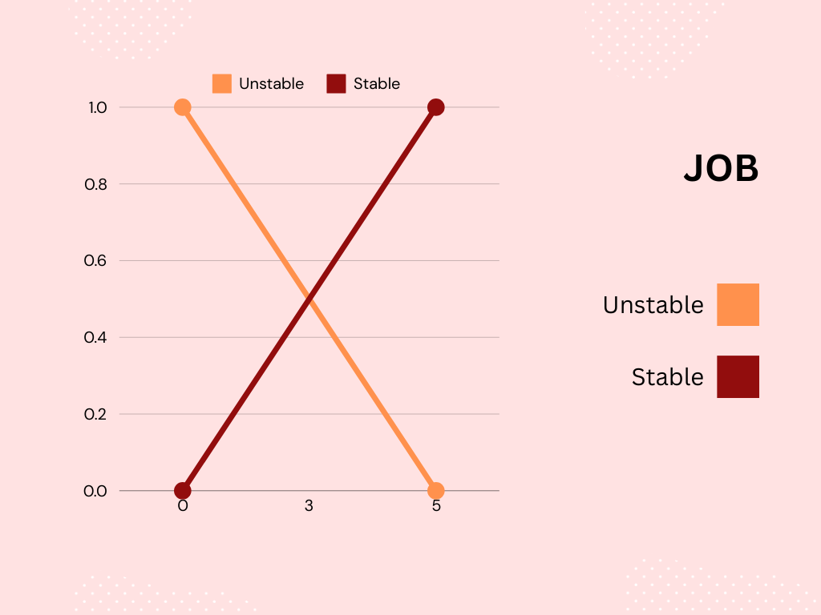
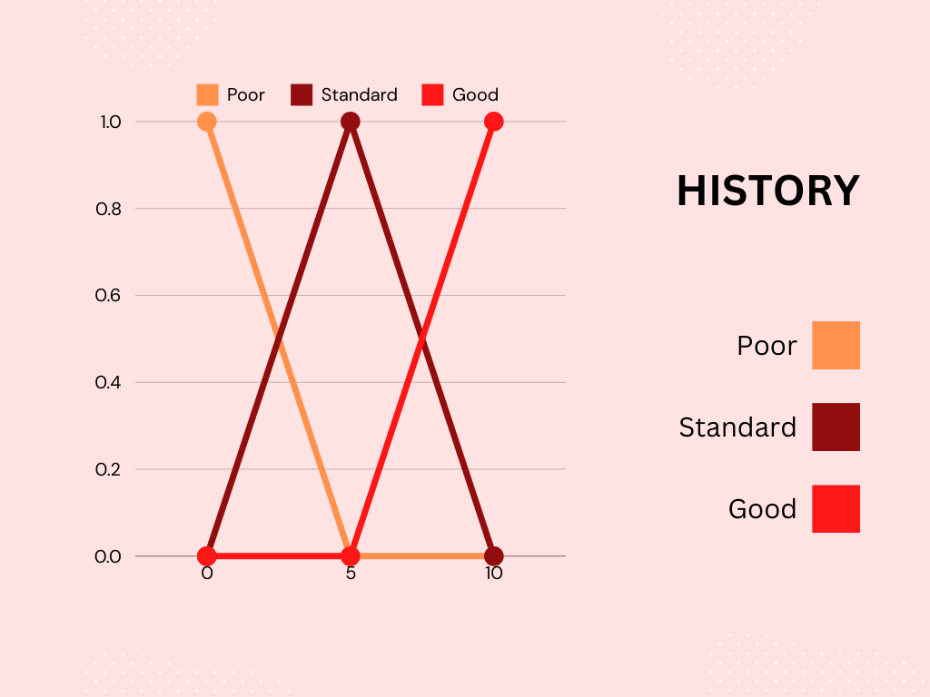
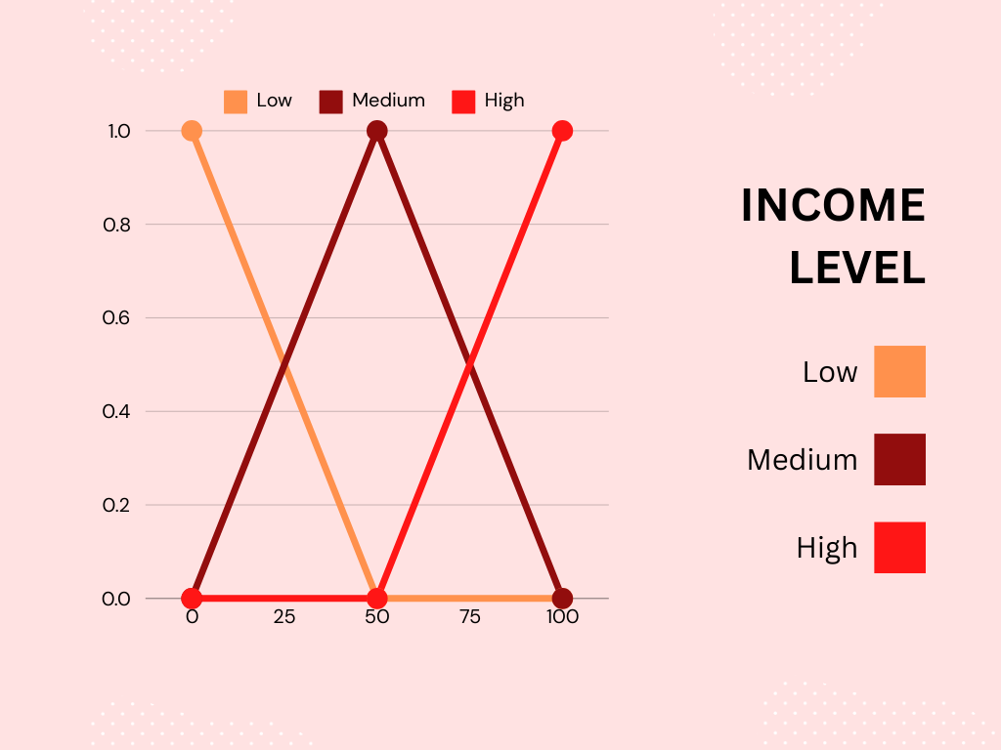
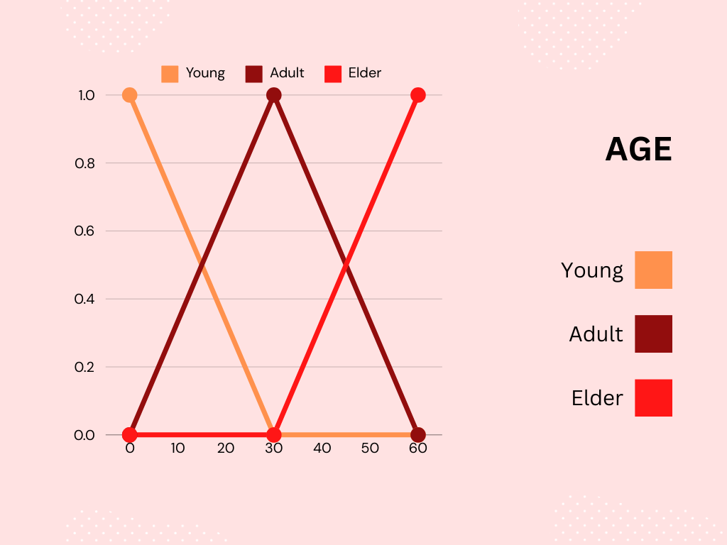

Description of the inference system
Notes:
hello

Slide 4
Methodology

Slide 5
Budget

Slide 6
Thank you!

